Slide 1

Software Defects binary Classification using Machine Learning CS 584 – Machine Learning
Anthony Rodriguez (A20547980)
Deshon Langdon (A20503832 )

Slide 2

Problem Statement
Software defects, also known as bugs, are a common occurrence in the software development process.
Lack of early detection of these defects is crucial to prevent such failures and ensure the smooth operation of systems
Manual software detection is very time-consuming and labor-intensive
Difficult to effectively allocate resources for defect management
Scalability and Feasibility issues
Expensive it is to fix after deployment
Notes:
Here is the nature of our problem
Software defects, also known as bugs, are a pretty much common occurrence in the software development process.
Lack of early detection is crucial to prevent such failures and ensure the smooth operation of systems but very time-consuming and labor-intensive.

Slide 3
Proposed Solution & Dataset
Implement various supervised machine learning models for binary classification of software defects. Models include :
Gaussian Naive Bayes, Random Forest Classifier
Bernoulli Naive Bayes, Gradient Boosting Classifier
Decision Tree Classifier, Histogram-based Gradient Boosting Classification Tree
K-Nearest Neighbors Classifier, Light Gradient Boosting Machine
Logistic Regression, Extreme Gradient Boosting
CatBoost Classifier.
Dataset: Binary Classification with a Software Defects Dataset initially containing 169,605 samples. Dataset contained 21 predictors and 1 label column.
Contains 101,763 training (later split into 81410 - 81411 training samples, and 20353 – 20352 validation samples as the K folds rotated in epoch)
Each row represents a software instance and is labeled under the ‘defects’ column as either ‘False’ (0) or ‘True’ (1), indicating the absence or presence of a software defect.
Notes:
Therefore, our solution is to Implement various supervised machine learning models as shown below to classify whether a software has defects or not.
Then compare those performance to find the most effective model for predicting software defects.
The dataset used for this project is called Binary Classification with a Software Defects Dataset which taken from Kaggle competition playground season 3 series,
which comprised of 21 predictors and 1 label column with total of 101, 763 training
the Y label column each instance was labeled as False or true indicating the absence or presence of a software defect.

Slide 4

Proposed Solution & Dataset cont’d
Objective:
Compare the performance of various models to find the most effective model for predicting software defects.
Use the validation set as the test set to evaluate the models’ performances.
Notes:
Use the validation set as the test set to evaluate the models’ performances

Slide 5

Workflow
Data Exploration
Data
Pre-processing
Data
Modelling
Feature selection
Outlier Detection and Standardization
Split dataset into training & validation
Gaussian Naive Bayes
Bernoulli Naive Bayes
Decision Tree Classifier
K-Nearest Neighbours Classifier
InceptionV3
Logistic Regression
Random Forest Classifier
Gradient Boosting Classifier
Histogram-based Gradient Boosting Classification Tree
Checking Missing Values in entries
Checking Duplicates entries
Data Distribution of features and label (defects)
Correlation Analysis
Notes:
Here the overview of workflow for this project, where
Firstly, we have Data Exploration involved checking Missing Values and Duplicates entries. Then Data Distribution of features and Y label, then some Correlation Analysis
Then second phase of Data Pre-processing involved feature selection Outlier Detection and Standardization and basic spilt into training and validation sets
Then perform some data modeling of the data through the various supervised machine learning models Decision Tree Classifier, Logistic Regression etc

Slide 6
Workflow cont’d
Data
Modelling
Evaluate Results
Data
Modelling
Label validation Data
•Light Gradient Boosting Machine
Extreme Gradient Boosting
CatBoost Classifier
Repeated K-Fold Cross Validation
Evaluation on baseline model
Hyperparameter tuning
Plotting loss and accuracy
Predicting labels for validation data using each optimized model
Model Evaluation on the optimized models
Notes:
Then we went to Evaluating Results phase which involved repeated K-Fold Cross Validation,
evaluation on baseline model and comparison to others,
hyperparameter tuning and
pretty much plotting loss and accuracy
In final stage we did some predicting again but this time using the optimized models. Afterwards we perform model evaluation on those optimized models can compared to baseline results and also to other optimized models

Slide 7
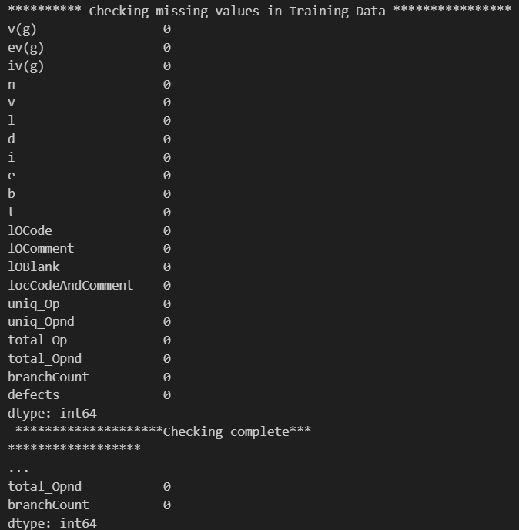
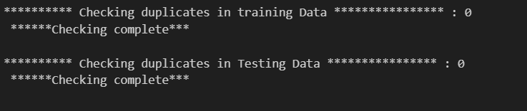
Data Exploration
Both checking missing values and duplicates in entries of the dataset give 0 as the results
Notes:
Under Data Exploration we performed a basic simple checking of any form of missing values duplicates in the in datasets where both give 0 as results .
Missing values can affect the performance of the model later one, so it’s was important that to identify and handle them appropriately and duplicates entries can create bias in models ,
therefore they need to be identified and removed.

Slide 8
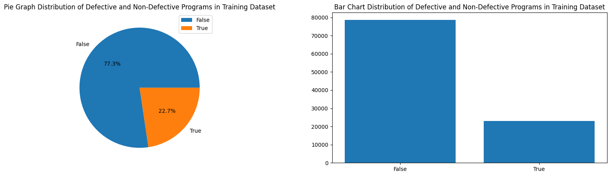
Defects Distribution
Perform visualization of distribution of defective and non-defective programs in the training dataset.
73.33% Not- Defects and 22.7% defects
Notes:
We Perform visualization of distribution of programs being defective or not in the training dataset. As shown in graph above was unbalance between the two classes in the dataset 73.33 % where not defects where the remaining 22.7 % where defects,

Slide 9
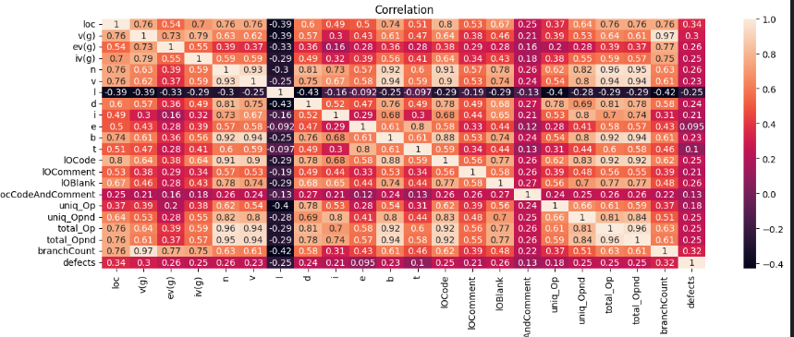
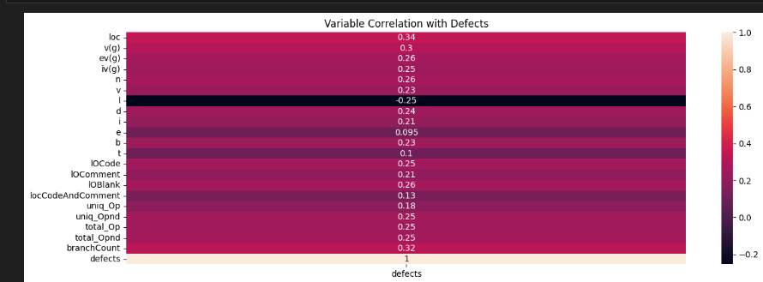
Correlation Analysis
Notes:
Then we went on to visualizing the correlation between different features in the dataset and also with y label (defects).
Most of features in dataset as shown in matrix have high positive correlation to each other
and also with the Y label shown in heat map
however, what stood out was the Feature “I” had showed a negative correlation between all features in dataset here and also to (y) label.

Slide 10
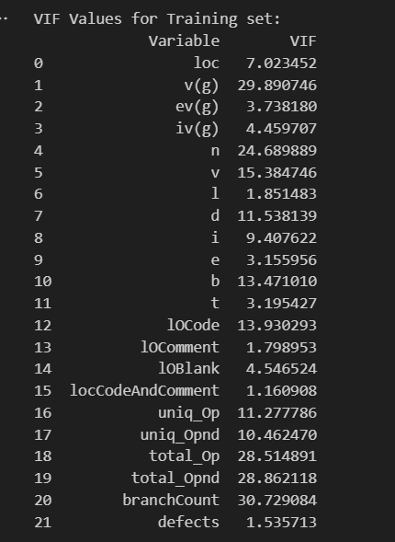
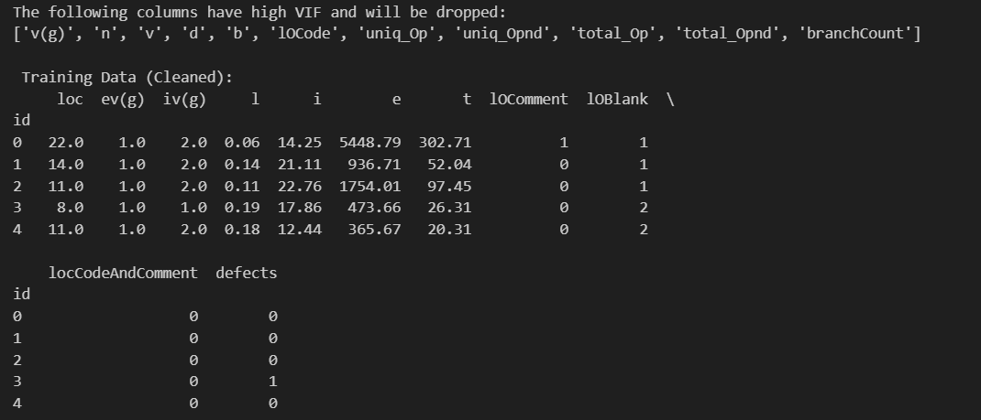
Feature Selection
Perform variance Inflation Factor (VIF) for each feature.
Features with a high VIF are highly correlated with other features and can cause problems in the model, so they are dropped
Notes:
Building on the analysis gathered from data exploration we used variance Inflation Factor (VIF) on each feature to calculate their VIF values
being that we found such interesting multicollinearity in the among features and the Y label.
Features that give high VIF scores as shown above the set threshold of 10 was dropped
being that keeping these features would been problematic which can affect the stability
and interpretability of the model coefficients.

Slide 11
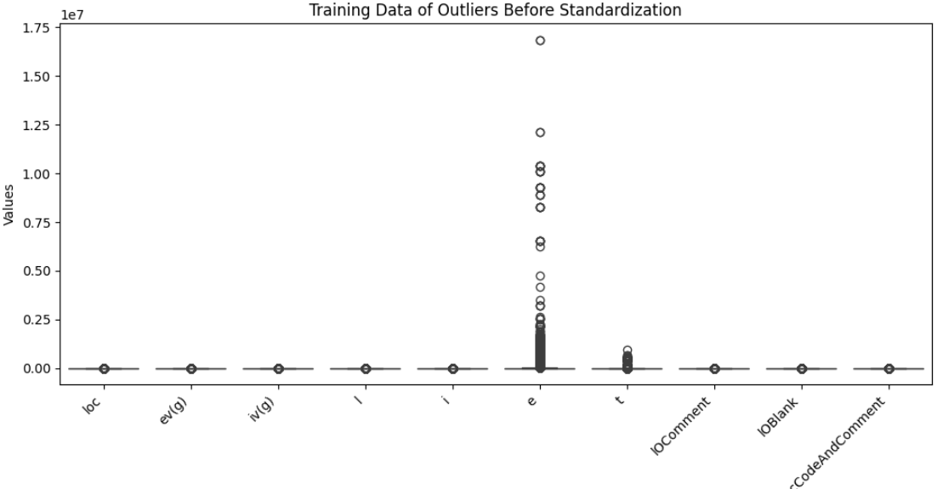
Outlier Detection and Standardization (Before)
Notes:
then went on to identifying and handling outliers in the data and standardization the data.
As shown here we found that the feature “E” has great amount of outlier's extreme values that
can skew the model’s performance, additionally all features had different scales
as shown the figure above.

Slide 12
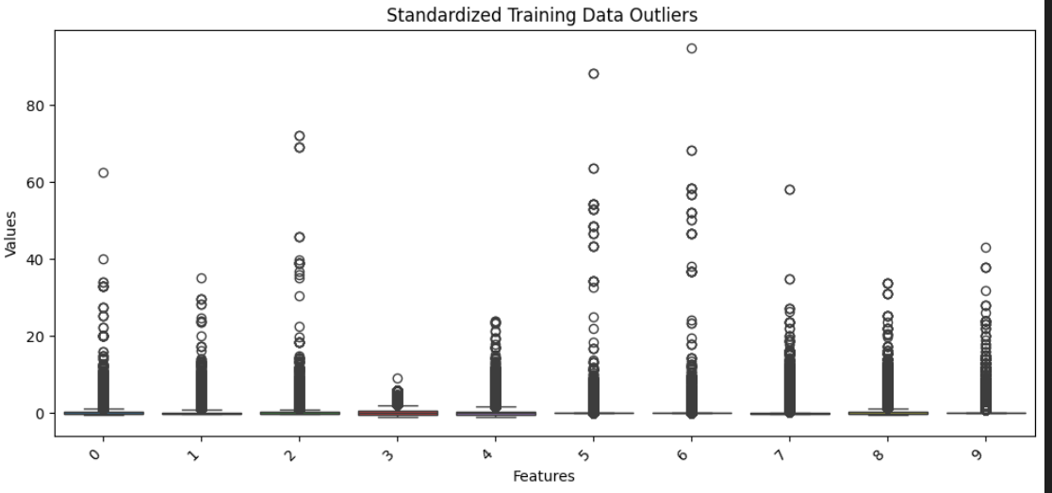
Outlier Detection and Standardization (After)
Notes:
Therefore , By the using StandardScaler() function here we standardized the data to a mean of 0 and a standard deviation of 1,
thus ensuring that all features are on the same scale and helps the model to converge faster as shown in figure above
Now I would pass you on to Anthony

Slide 13
Data Modeling
Implement a Cross Validation Strategy for Evaluating Each Model:
Gaussian Naive Bayes
Bernoulli Naive Bayes
Decision Tree Classifier
Classification Tree
K-Nearest Neighbors Classifier
Logistic Regression
CatBoost Classifier
Implemented Cross Validation using Repeated Stratified K Fold Sampling (5 folds and 5 Repeats)
Evaluated Each Model Based Upon:
Accuracy:
Percentage of observations correctly classified.
ROC AUC Score:
Probability that the model can distinguish between positive and negative classes.
F1 Score:
Harmonic Mean of Precision and Recall Scores
2*(Precision*Recall)/(Precision+Recall)
Random Forest Classifier
Gradient Boosting Classifier
Hist Gradient Boosting
Light Gradient Boosting
Extreme Gradient Boosting

Slide 14
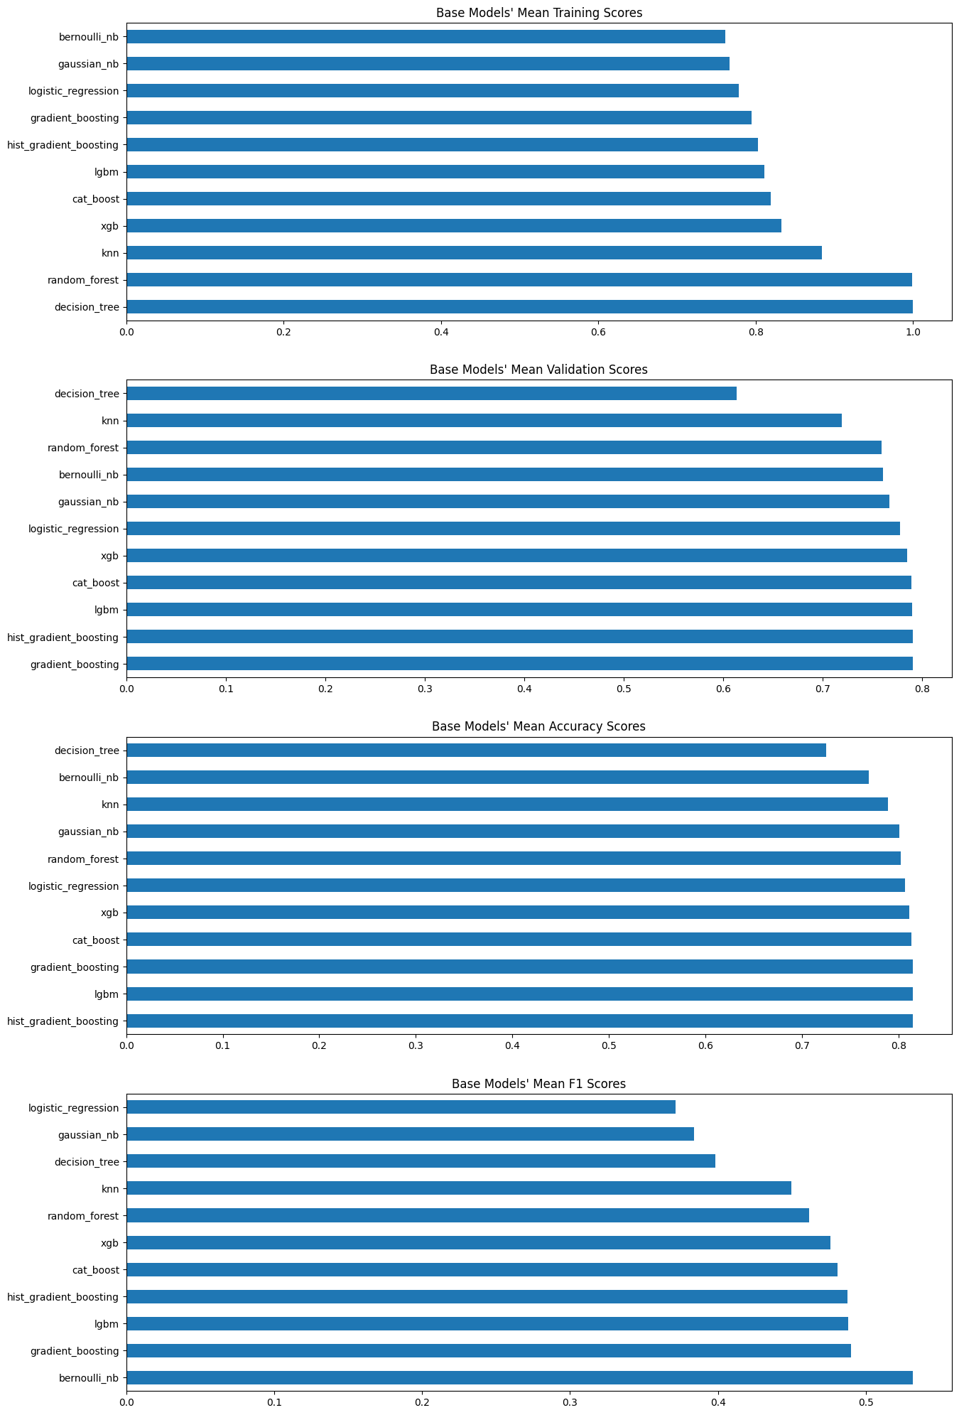
Base Model Results

Slide 15
Base Model Results
Model Name | Ave. Training ROC AUC Score | Ave. Validation ROC AUC Score | Ave. Accuracy | Ave. F1 Score
Gaussian NB | 0.7671589 | 0.7671437 | 0.8006672 | 0.3837027
Bernoulli NB | 0.760931 | 0.7608771 | 0.7692737 | 0.5317257
Decision Tree | 0.9995711 | 0.6138554 | 0.7248548 | 0.3985115
KNN | 0.884046 | 0.7194356 | 0.7890225 | 0.4495136
Logistic Regression | 0.7781648 | 0.7780576 | 0.8067461 | 0.3711798
Random Forest | 0.9985411 | 0.759114 | 0.8024754 | 0.461492
Gradient Boosting | 0.7948394 | 0.7906932 | 0.8146203 | 0.4898802
Hist Gradient Boosting | 0.8028327 | 0.7906572 | 0.8147686 | 0.4876493
LGBM | 0.810897 | 0.7903612 | 0.8147549 | 0.4881741
XGB | 0.8323212 | 0.7849803 | 0.8113244 | 0.4759125
Cat Boost | 0.8193732 | 0.7892677 | 0.8130283 | 0.4809887

Slide 16
Hyper Parameter Tuning
Gaussian Naive Bayes Variance Smoothing Portion of the largest variance of all features that is added to variances. Decision Tree Criterion Function to Measure Quality of Split Max Tree Depth K Neighbor Classifier Neighbors Number of Neighbors Logistic Regression Solvers Optimization Algorithm C Values Inverse Regularization Strength | Bernoulli Naive Bayes Alpha Additive Smoothing Parameter Random Forest Max Tree Depth Max Features Number of Features to Consider for Best Split Hist Gradient, Gradient Boosting, & Extreme Gradient Boosting Max Tree Depth Learning Rate Cat Boosting Max Tree Depth Light Gradient Boosting Machine Max Tree Depth Max Number of Leaves Max Number of Leaves Per Tree

Slide 17
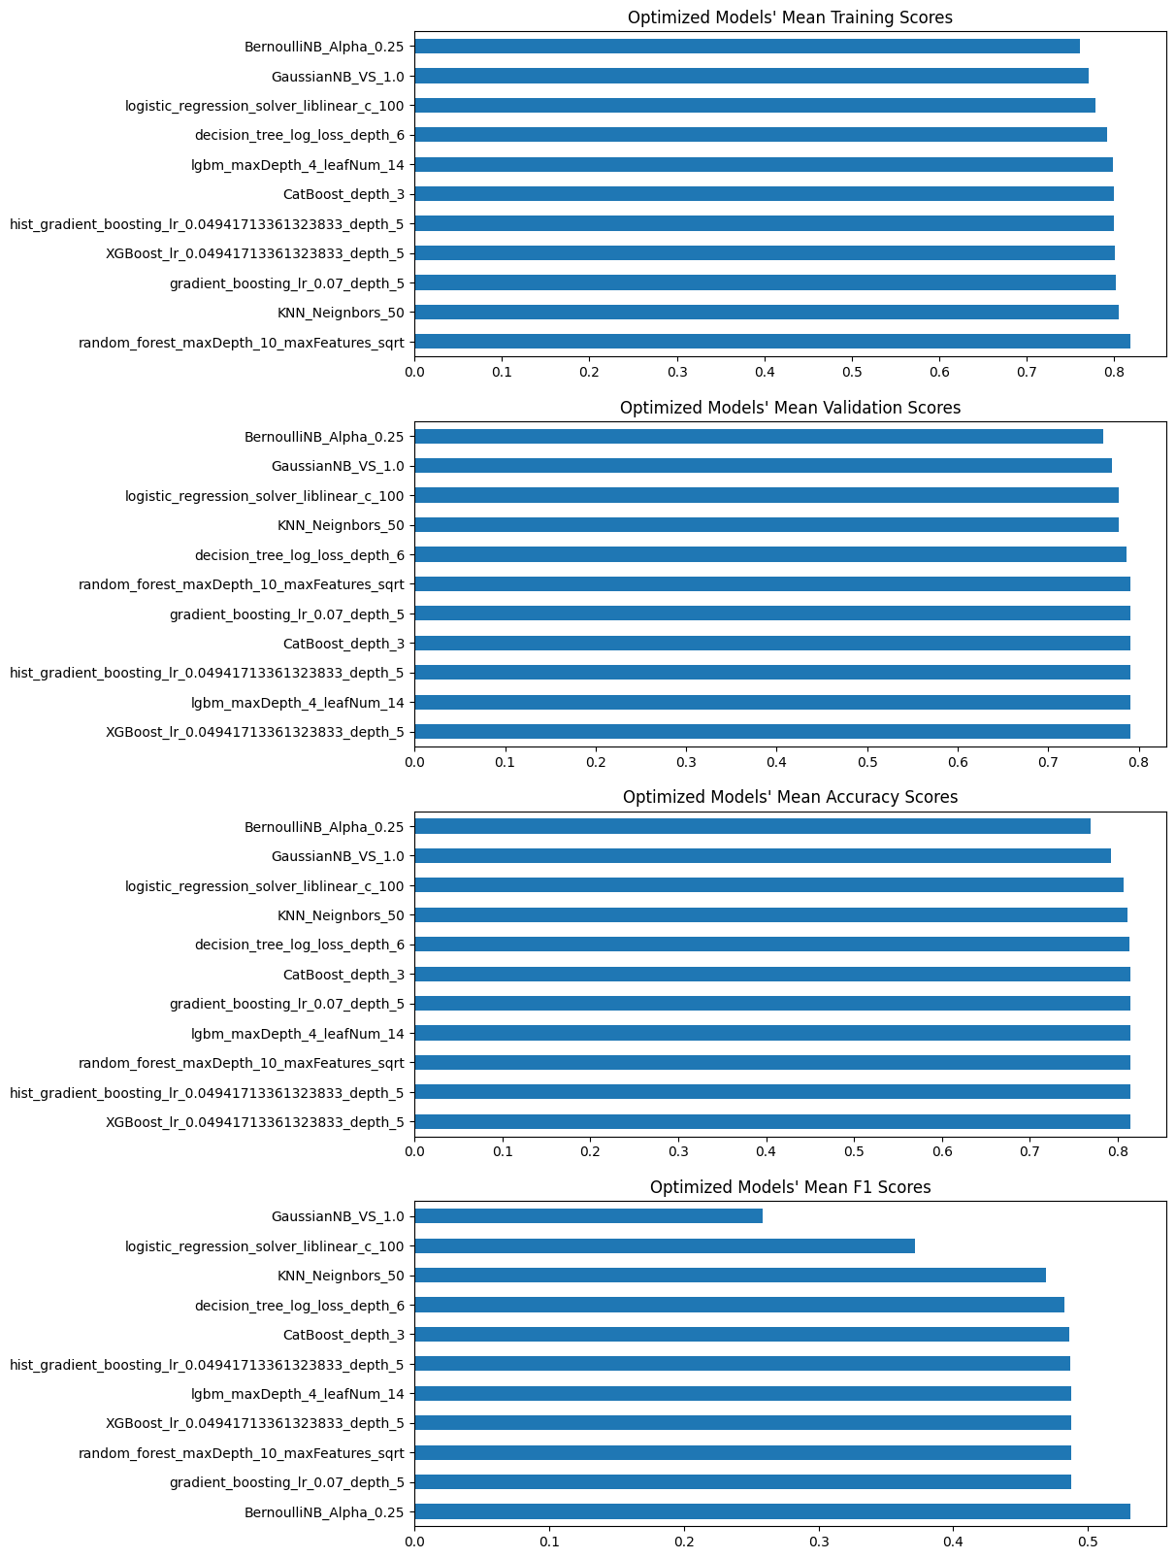
Optimized Model Results

Slide 18
Optimized Model Results
Model Name | Ave. Training ROC AUC Score | Ave. Validation ROC AUC Score | Ave. Accuracy | Ave. F1 Score
GaussianNB_VS_1.0 | 0.7703925 | 0.7703802 | 0.7925759 | 0.2587808
BernoulliNB_Alpha_0.25 | 0.7609309 | 0.7608771 | 0.7692737 | 0.5317257
decision_tree_log_loss_depth_6 | 0.7916948 | 0.7865117 | 0.8135423 | 0.4824395
KNN_Neignbors_50 | 0.8051304 | 0.7781011 | 0.8117106 | 0.4686465
logistic_regression_solver_liblinear_c_100 | 0.7781662 | 0.7780591 | 0.80675 | 0.3712207
random_forest_maxDepth_10_maxFeatures_sqrt | 0.8188424 | 0.790596 | 0.8148463 | 0.4876912
hist_gradient_boosting_ lr_0.04941713361323833_depth_5 | 0.7995138 | 0.7910308 | 0.8148699 | 0.4870412
lgbm_maxDepth_4_leafNum_14 | 0.7983258 | 0.7911049 | 0.8146743 | 0.4876798
gradient_boosting_lr_0.07_depth_5 | 0.8023741 | 0.7909673 | 0.8146645 | 0.4877596
XGBoost_lr_0.04941713361323833_depth_5 | 0.800319 | 0.7911931 | 0.814921 | 0.4876838
CatBoost_depth_3 | 0.7994325 | 0.791019 | 0.8144041 | 0.4859718

Slide 19
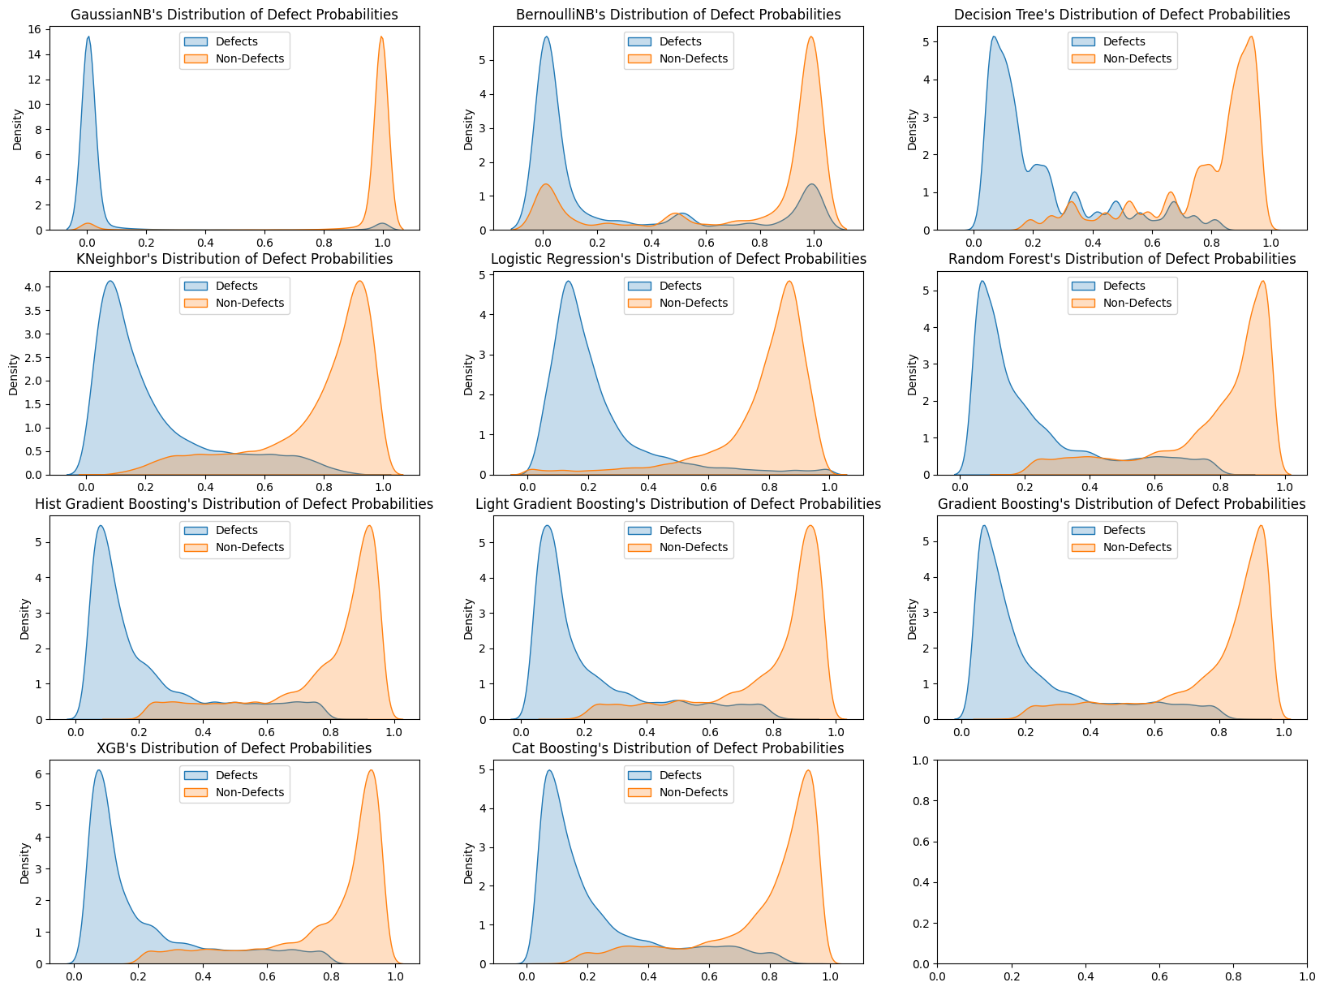
Optimized Model Testing Data Defect Probabilities

Slide 20
Planned Future Work
Implementing a Custom Classifier Ensemble Based Upon Our Data To Improve Results.
Evaluate Our Data Preprocessing Methods To Better Optimize Our Models.
Evaluate Our Model Performance Metrics For Better Selection and Optimization of Models.

Slide 21


